Slide 1
Combinatorics

Slide 2
Permutations and combinations
Assume you go to a café and can choose between 3 hot drinks (latte, americano, tea) and 3 different types of cakes (chocolate, carrot, lemon). What is the total number of possible combinations?
Assume you have an urn with 5 balls of 5 different colours. How many different possibilities are there to draw 2 balls? More generally, how many different possibilities are there to draw m balls out of n balls?

Slide 3
Permutations
Consider a set of n elements. We want to count how many different are there to order them.
Example: There were 3 candidate cities to host the Olympic Games 2020: Madrid (M), Tokyo(T) and Istambul (I). Before the election, there were the following possible rankings of the cities:
M,T,I
M,I,T
I,M,T
I,T,M
T,M,I
T,I,M
We have 3 possibilities for the first position, 2 for the second one, and 1 for the last one. Hence: 3 x 2 x 1=6 total possibilites.

Slide 4
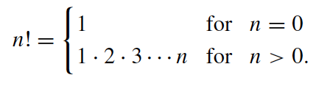
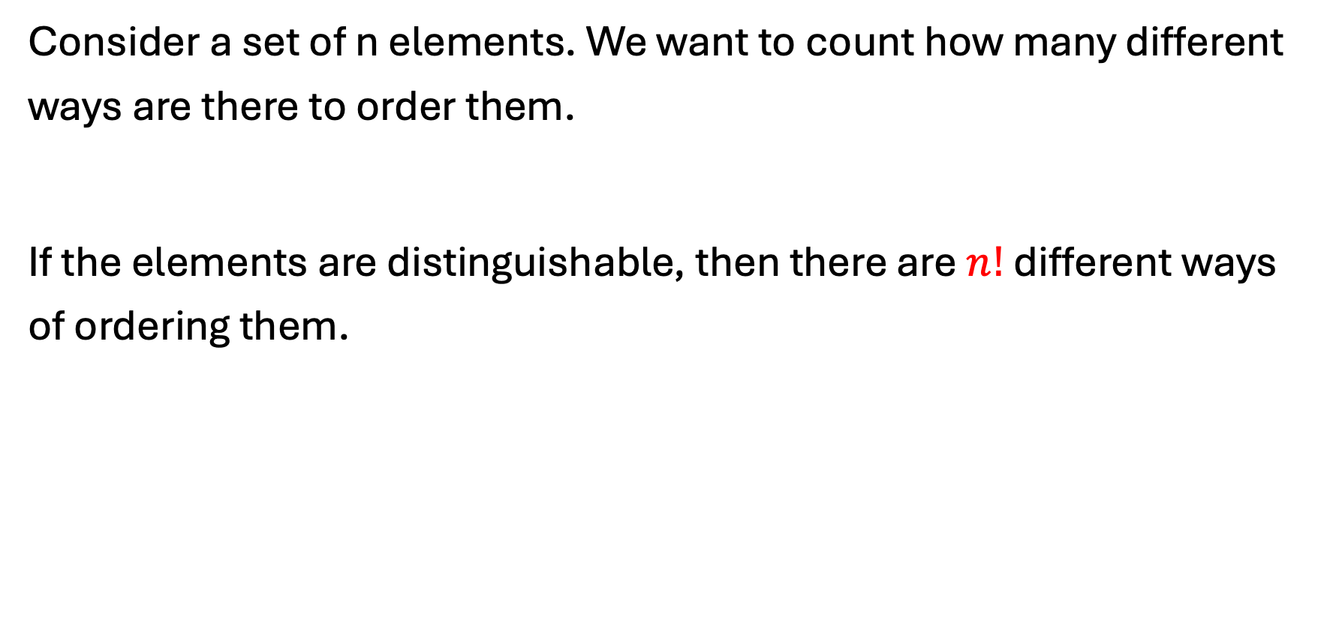
Permutations
Consider a set of n elements. We want to count how many different ways are there to order them.
If the elements are distinguishable, then there are $n!$ different ways of ordering them.
factorial

Slide 5
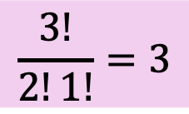
If not all elements are distinguishable:
Suppose we have an urn with 2 black (B) balls and 1 white (W) ball. How many different ways are there to pick 3 balls?
B,B,W
B,W,B
W,B,B
Notice that the two black balls are not distinguishable.
$$\frac{3!}{2!1!}=3$$

Slide 6
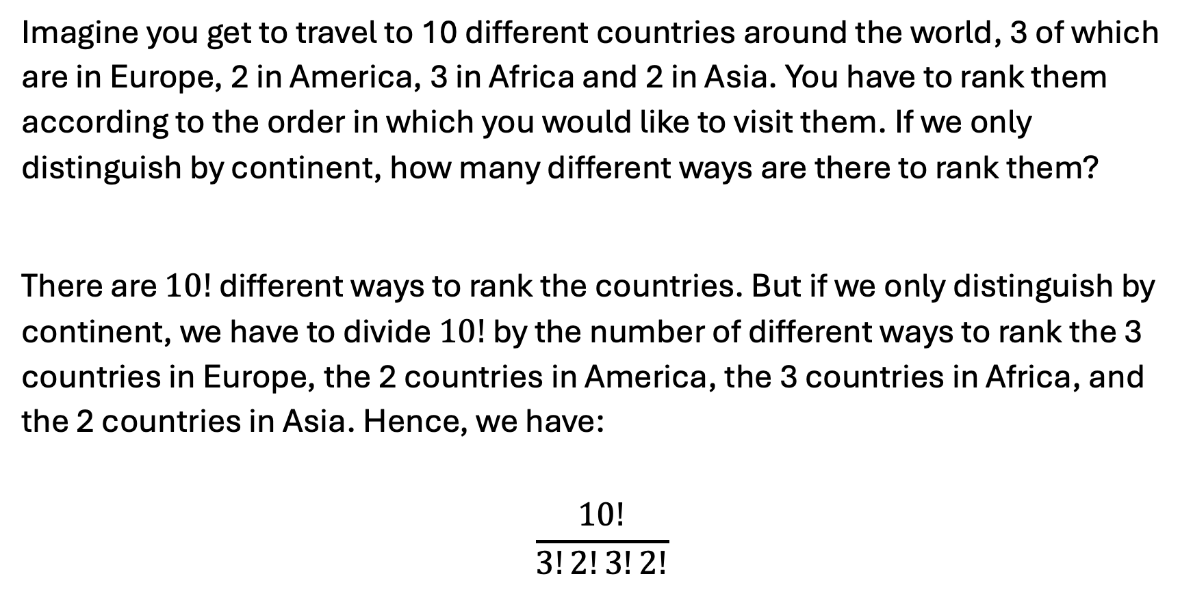
Example:
Imagine you get to travel to 10 different countries around the world, 3 of which are in Europe, 2 in America, 3 in Africa and 2 in Asia. You have to rank them according to the order in which you would like to visit them. If we only distinguish by continent, how many different ways are there to rank them?
There are $10!$ different ways to rank the countries. But if we only distinguish by continent, we have to divide $10!$ by the number of different ways to rank the 3 countries in Europe, the 2 countries in America, the 3 countries in Africa, and the 2 countries in Asia. Hence, we have:
$$\frac{10!}{3!2!3!2!}$$

Slide 7
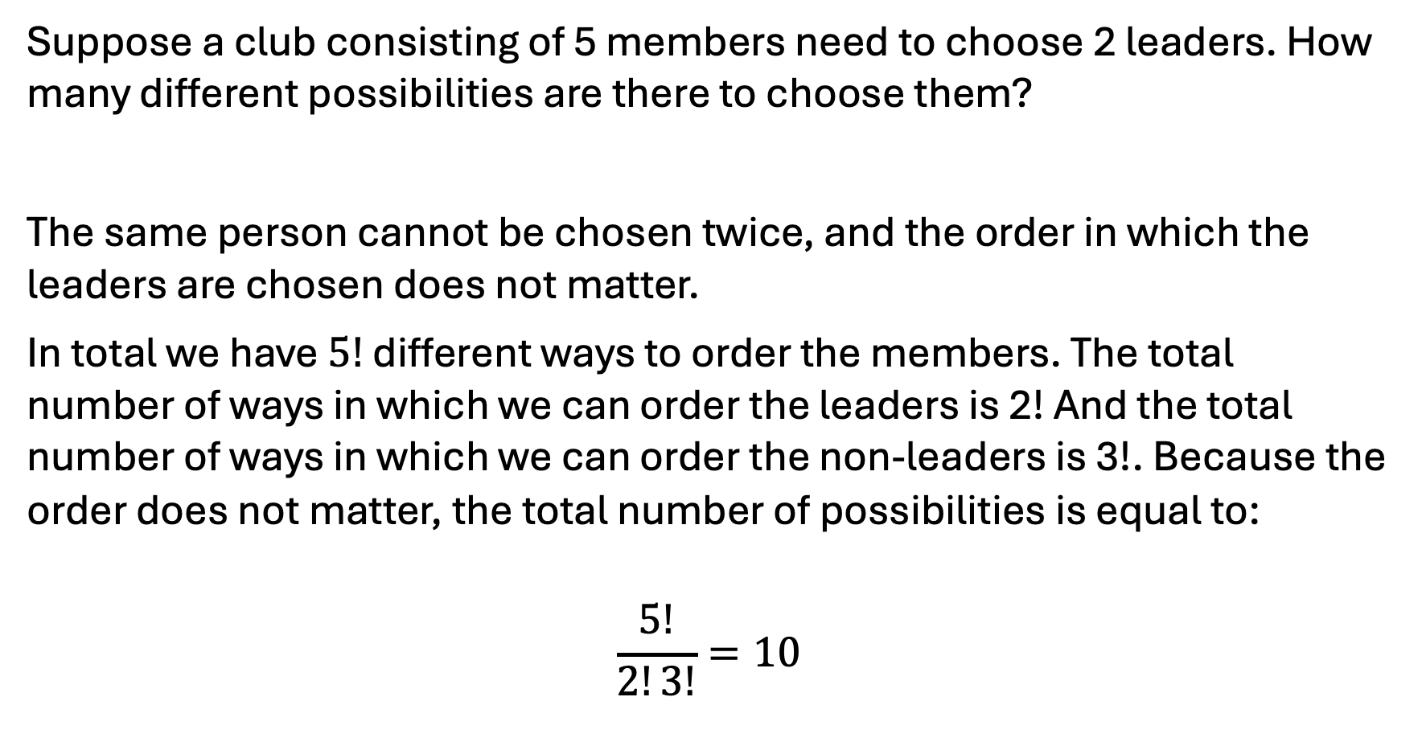
Combinations without replacement and without consideration of order
Suppose a club consisting of 5 members need to choose 2 leaders. How many different possibilities are there to choose them?
The same person cannot be chosen twice, and the order in which the leaders are chosen does not matter.
In total we have $5!$ different ways to order the members. The total number of ways in which we can order the leaders is 2! And the total number of ways in which we can order the non-leaders is 3!. Because the order does not matter, the total number of possibilities is equal to:
$$\frac{5!}{2!3!}=10$$

Slide 8

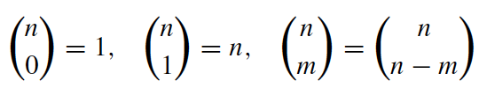
Combinations without replacement and without consideration of order
The total number of different ways in which we can choose m out of n elements, where we choose without replacement, and order is not important, is equal to:
Binomial coefficient
rules

Slide 9

Binomial coefficient: example
A company needs to elect a board of directors. The board consists of 5 members and 15 people are eligible. How many different combinations do exist for the board?

